Slide 1

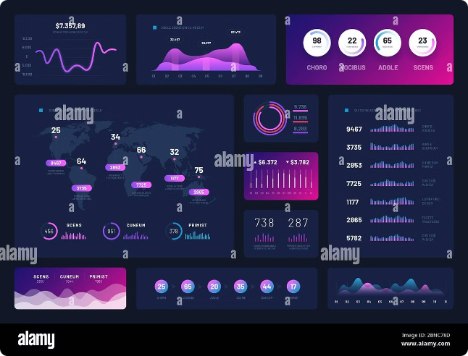
OTT Dashboard
Dive into the world of streaming with this comprehensive OTT Dashboard. Get a detailed overview of your platform's performance, user engagement, and revenue. This dashboard provides actionable insights to drive strategic decisions and optimize your streaming experience.

Slide 2

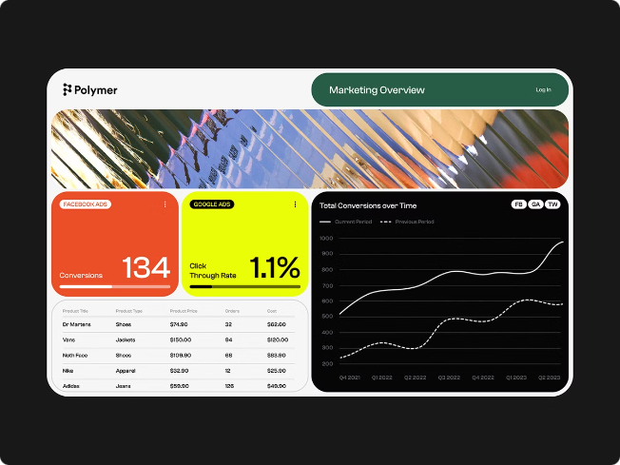
Overview
This dashboard provides a holistic view of your OTT platform's performance. You'll find key metrics, user engagement trends, content performance insights, and revenue analysis. All data is visualized for easy understanding.
Key Metrics
User Engagement
Track essential metrics like subscriber growth, average viewing time, and churn rate.
Analyze user activity, understand content preferences, and identify areas for improvement.
Content Performance
Revenue Insights
Measure the success of your content library, identify popular titles, and understand viewer preferences.
Monitor subscription revenue, advertising revenue, and other income streams.

Slide 3

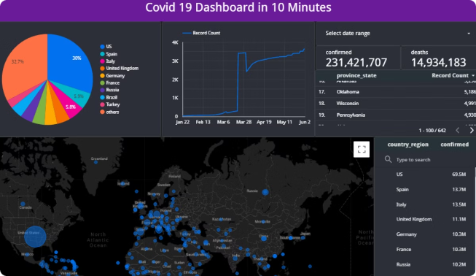
Key Metrics
Monitor the key performance indicators (KPIs) that drive your OTT platform's success. Understand the overall health of your platform and identify areas for growth.
Metric
Definition
Target
Total Subscribers
The number of active subscribers on your platform
1 million by Q4 2023
Average Viewing Time
The average time users spend watching content on your platform
2 hours per day
Churn Rate
The percentage of subscribers who cancel their subscriptions
Less than 5% per month

Slide 4

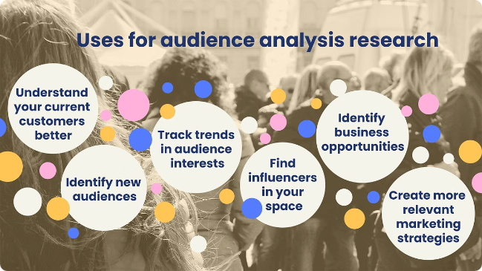
User Engagement
Understand how users interact with your platform. Analyze user behavior to improve content recommendations and personalize the user experience.
1
Content Consumption
2
Search & Discovery
Analyze how users interact with your content library, such as the number of views, playbacks, and watch time.
Track user searches and discover how they find content on your platform.
3
User Feedback
4
App Usage
Monitor user ratings, reviews, and feedback to understand their preferences and identify areas for improvement.
Track app usage metrics such as logins, app sessions, and device types to understand how users interact with your app.

Slide 5

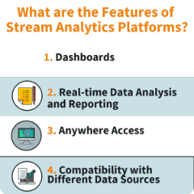
Content Performance
Gain insights into the performance of your content library, including popularity, viewership trends, and user engagement metrics.
Content Popularity
User Engagement
Identify the most popular titles based on viewership metrics like number of views and average watch time.
Measure user engagement with your content library, including metrics like average watch time, completion rate, and user ratings.
1
2
3
Viewership Trends
Analyze trends in viewership patterns over time, such as the popularity of specific genres or content categories.

Slide 6
Subscriber Trends
Track subscriber growth, churn rate, and other key metrics related to subscriber acquisition and retention.
Subscriber Growth
Churn Rate
Subscription Packages
Track the total number of subscribers over time and identify key trends in subscriber acquisition.
Analyze the percentage of subscribers who cancel their subscriptions each month and identify potential causes.
Analyze the performance of different subscription packages and identify which packages are most popular.

Slide 7

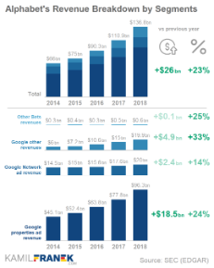



Revenue Insights
Understand your revenue streams, track financial performance, and identify opportunities for growth.
Subscription Revenue
Advertising Revenue
Other Revenue
Analyze subscription revenue growth, identify key factors driving revenue, and understand the impact of pricing strategies.
Track advertising revenue, analyze the effectiveness of ad campaigns, and identify opportunities for growth.
Analyze revenue from other sources such as merchandise sales, content licensing, and partnerships.

Slide 8

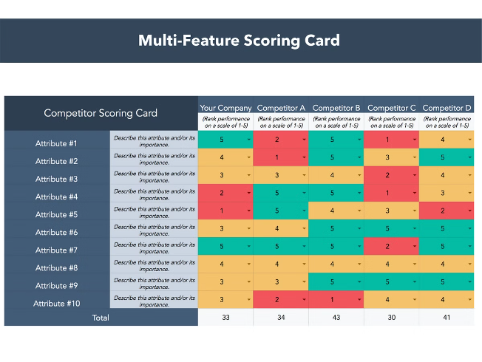



Platform Comparisons
Benchmark your platform against competitors to identify areas for improvement and gain a competitive advantage.
Key Metrics
Compare your key metrics, such as subscriber growth, average viewing time, and churn rate, to industry benchmarks and competitors.
Content Library
Analyze the size and diversity of your content library and compare it to that of your competitors.
User Experience
Evaluate your user experience against competitors, including app design, navigation, and content discovery features.

Slide 9


Recommendations
This dashboard provides actionable recommendations based on data analysis to help you optimize your OTT platform for growth and success.
1
Content Strategy
2
User Engagement
Recommendations for improving your content library, including genre diversification, content licensing, and original content production.
Recommendations for improving user engagement, such as personalization, content recommendations, and interactive features.
3
Marketing & Promotion
4
Technical Improvements
Recommendations for promoting your platform, including social media campaigns, paid advertising, and content marketing.
Recommendations for improving the technical performance of your platform, such as app optimization, streaming quality, and security measures.

